Slide 1
CAPSTONE EDA PROJECT
HOTEL BOOKINGS ANALYSIS
By Amit s kashyap

Slide 2
Steps followed
Importing necessary packages and libraries.
Mount the drive in colab and read the .csv file.
Analysing the data sheet.
Removing null/NAN/duplicate rows.
Drop certain columns/combined certain columns to make our data sheet free Avoid of any irrelevant data.
Applying the concept of Data Wrangling and Data Visualization such that we can analyse the data sheet and retrieve required information.

Slide 3
Problem Statement
Have you ever wondered when the best time of year to book a hotel room is? Or the optimal length of stay in order to get the best daily rate? This hotel booking dataset can help you explore those questions!
This data set contains booking information for a city hotel and a resort hotel, and includes information such as when the booking was made, length of stay, the number of adults, children, and/or babies, and the number of available parking spaces, among other things. All personally identifying information has been removed from the data. Explore and analyze the data to discover important factors that govern the bookings.e

Slide 4
Description of columns
Column_name | Column_description
Hotel | Contain data values hotel City ,Resort
is_canceled | Contains boolean data values 0→not_canceled 1→canceled
lead_time | Number of days between the entering date of booking and arrival date
arrival_date_year | Year of the arrival date of guests
arrival_date_month | Month of the arrival date of guests
arrival_date_week_number | Week number of year of arrival date
arrival_date_day_of_month | Day of the arrival of guests

Slide 5
distribution_channel | TA/TO
is_repeated_guest | Having values 1->repeated guests 0->no repeated guests
previous_cancellations | Number of previous bookings that were cancelled by the guests prior to the current booking
Previous_booking_not_cancellations | Number of previous bookings that were not cancelled by the guests prior to the current booking
reserved_room_type | Room type -- reserved
booking_changes | Number of changes made to the booking from the moment the booking was entered on the pms until the moment of check-in or cancellation
deposit_type | Categorical values—No deposit , Refund, Non-refund
agent | ID of the travel agency made the booking

Slide 6
Stays_in_weekend_nights | Number of days for stay on weekend night
Stays_in_week_nights | Number of days for stay on week day
adults | Number of adults
children | Number of children
babies | Number of babies
meal | Type of meal offered
country | Countries from where guests arrived
market_segment | Categorical values like TA→Travel agent TO→ Tour Operators

Slide 7
company | ID of the company which made the booking
days_in_waiting_list | Number of days the booking was in the waiting list before it was confirmed
customer_type | Categorical values→ contract group, trasisent, party
Average_daily_rate | Obtained by dividing the sum of all lodging transaction by the total number of staying nights
required_car_parking_spaces | Number of car parking spaces used by guests
total_of_special_requests | Number of special requests made by guests(eg-extra bedsheet)
reservation_status | Contains the current status
total_members | Number of adults + Number of children + Number of babies

Slide 8
EDA visualization
Full_stay | Number of stays_in_weekend_nights + Number of stays_in_week_nights
Here we present some of the basic as well as some advanced observations retrieved from the data sheet.

Slide 9
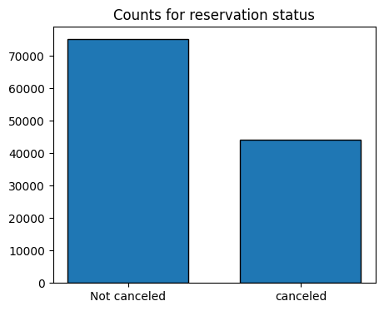
1. Counts for reservation status
As we observe from bar graph the cancelled percentage is approx 38% which is high, on the other hand the not cancelled are approx 63%.
.

Slide 10
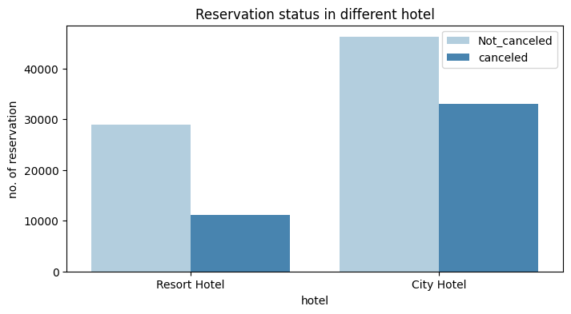
2.Reservation status in different hotels
The cancellation percentage of city hotel is higher than resort hotel. 27% cancelled in resort hotel where as 41% cancelled in the city hotel.

Slide 11
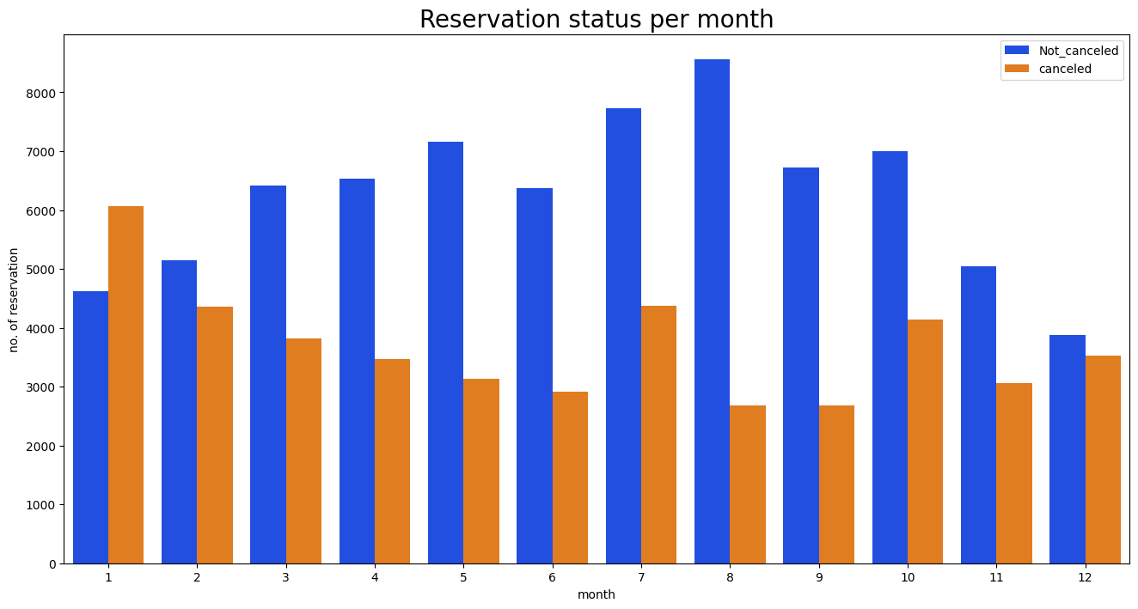
3.Reservation status month wise
The cancellation is higher in the month of january and get not cancelled is higher in the month of august. comparatively other months.

Slide 12
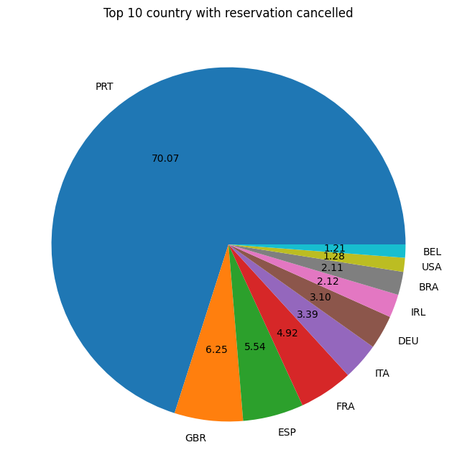
4. Top 10 country reservation cancelled
The 70% of booking or reservation get cancelled in portugal,and the great britain, spain, france are after that of around 17%.
.

Slide 13
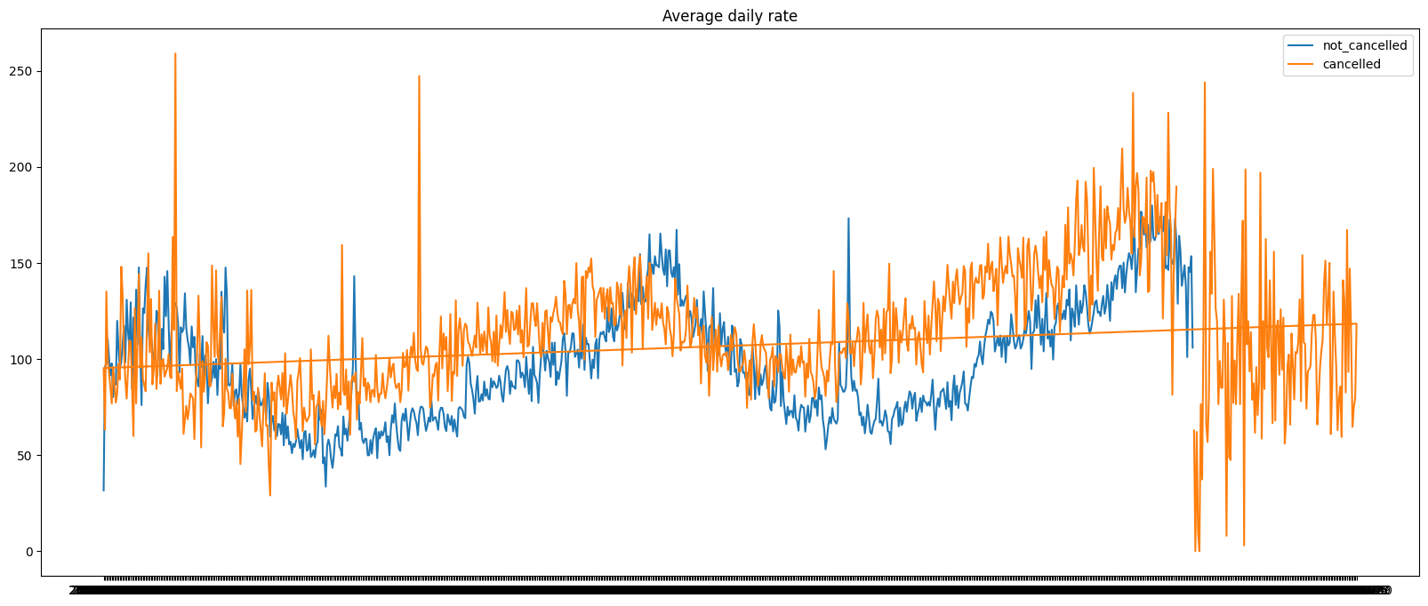
5. Average daily rates
There is inconsistancy in our dataset before 2015 and after 2017.This is could of any reason, so need to take into account only data between 2015 to 2017.

Slide 14
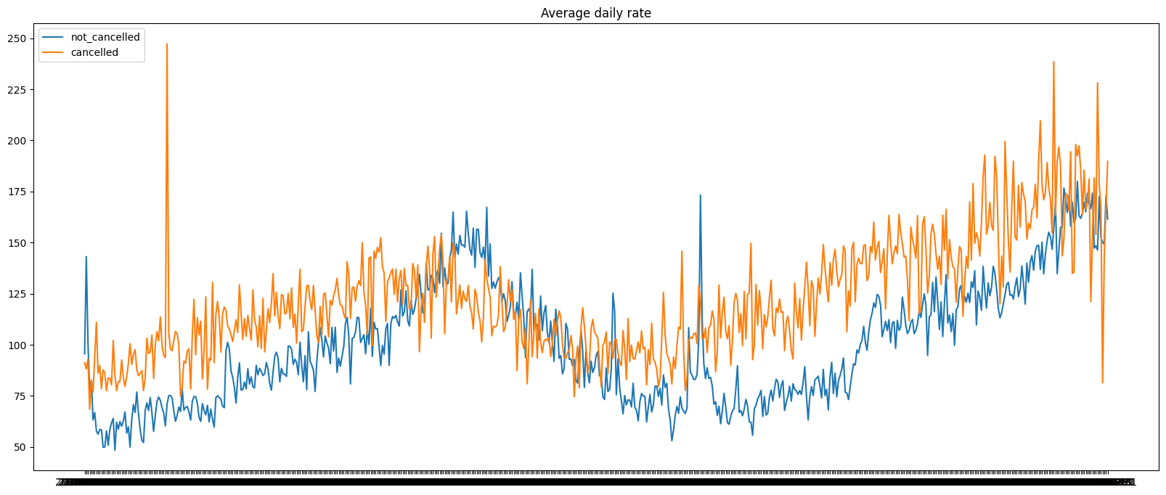
6. Average daily rates between 2016 to 2017
.

Slide 15
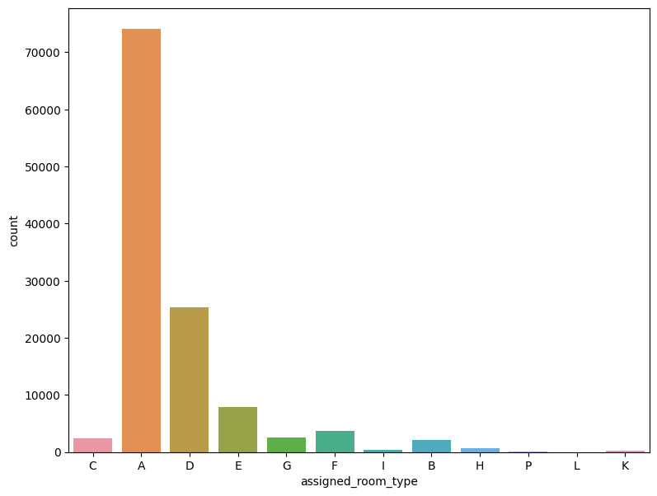
7.Assinged Room Type
The most preferable room type is type A and followed by type D, type E.

Slide 16
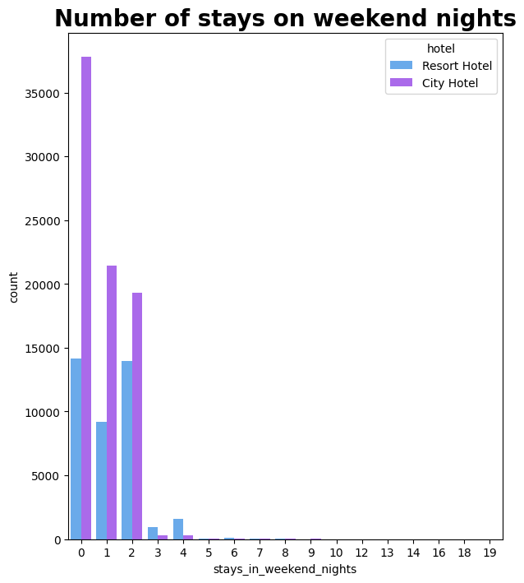
8. Stays on weekend
guest retention rate is low.
City hotel reservation is higher than resort hotel weekend stays night this can be due to price during weekend.

Slide 17
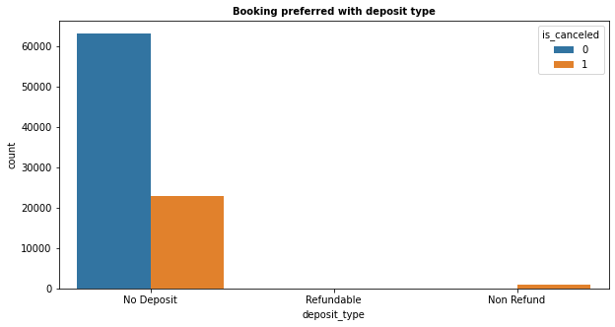
9. Bookings preferred with deposit type
As expected , Most Bookings are done with 'No deposit' and most cancellations are also in 'no deposit' bookings. It is a surprise to see cancellations with 'Non-refundable' bookings

Slide 18
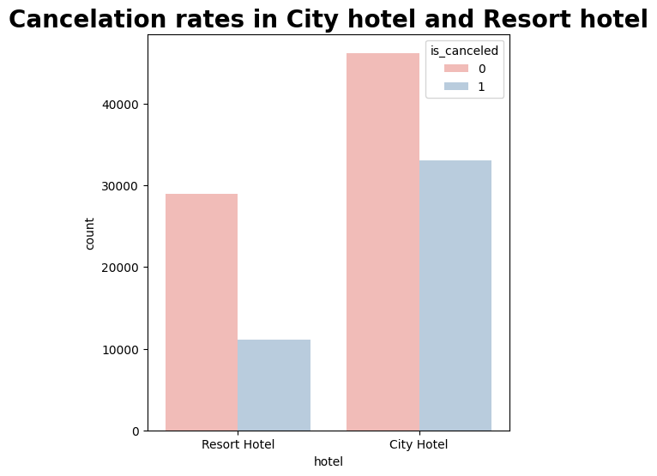
11.Cancellation rates in hotel
Kk
We observed rate of cancellation is higher in City hotel.
In year 2015 rate of cancellation was low.

Slide 19
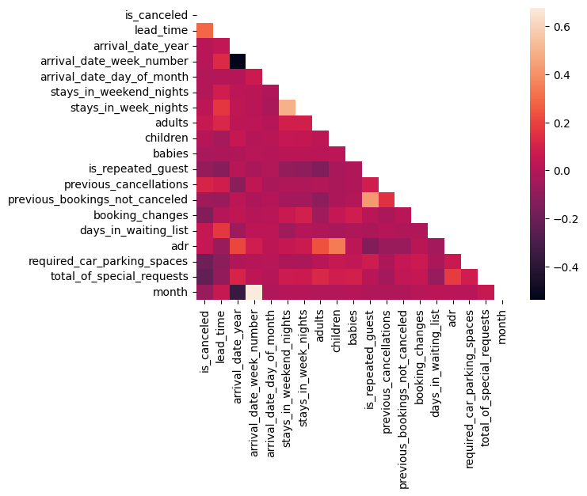
12.Analysing the correlation
Full_stay length and lead time have slight correlation. This may means that for longer hotel stays people generally plan little before the the actual arrival.
Average_daily_rate is slightly correlated with Total_members, which makes sense as more no. of people means more revenue, therefore more Average_daily_rate.

Slide 20

13. Pair plot
There are many variables which are mostly inter dependent to other variables due to this minor changes shows large variances such as price, room type, and many more.

Slide 21
Conclusion
Around 61% bookings are for City hotel and 39% bookings are for Resort hotel, therefore City Hotel is busier than Resort Hotel.
The majority of guests come from western Europe countries. We should spend a significant amount of our budget on those area.
July- August are the busiest and profitable months for both of hotels.
Couples are the most common guests for hotels, hence hotels can plan services according to couples needs to increase revenue.
July and August month have high Average daily price per person for resort hotel.
Most common stay length is less than 4 days and generally people prefer City hotel for short stay, but for long stays, Resort Hotel is preferred.
November,December, February And January are the months which has less booking this period you can get rooms with less average daily rate.
)

Slide 22
THANK YOU

